Slide 1
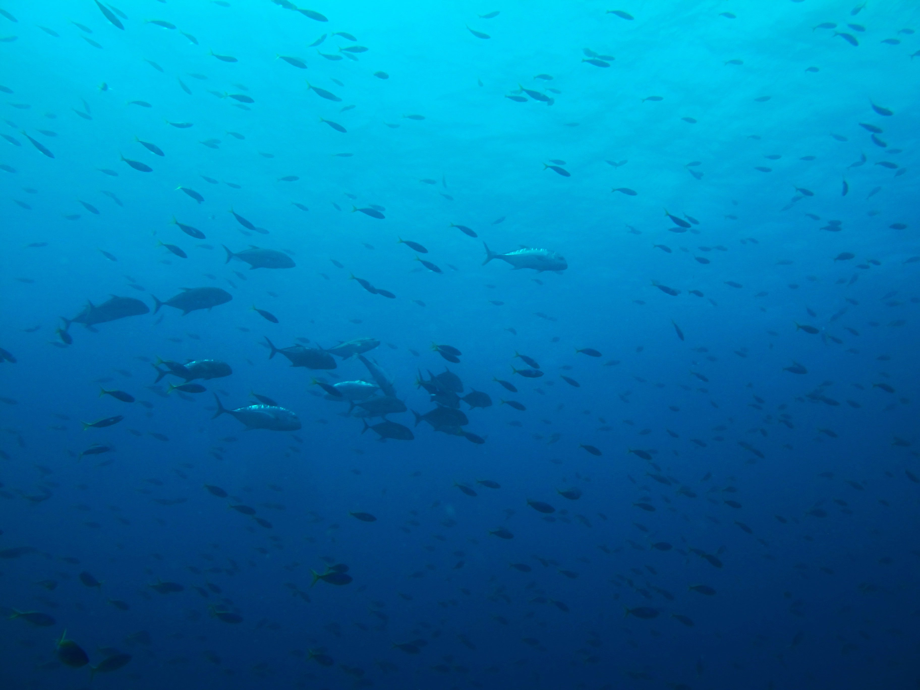
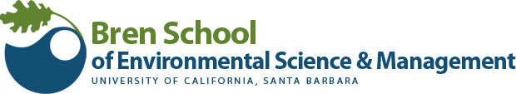
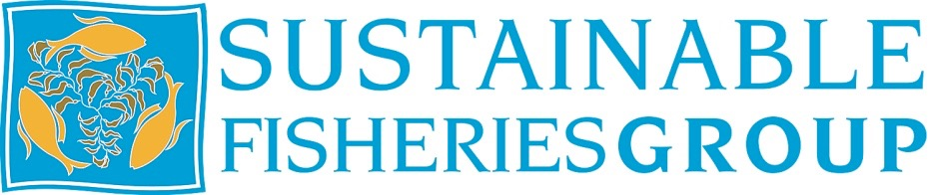
Solutions to the
Short-Term Economic Impacts of
Marine Reserves
Dan Ovando, Dawn Doughtery, Jono Wilson
AFS 2015 - Portland Oregon

Slide 2
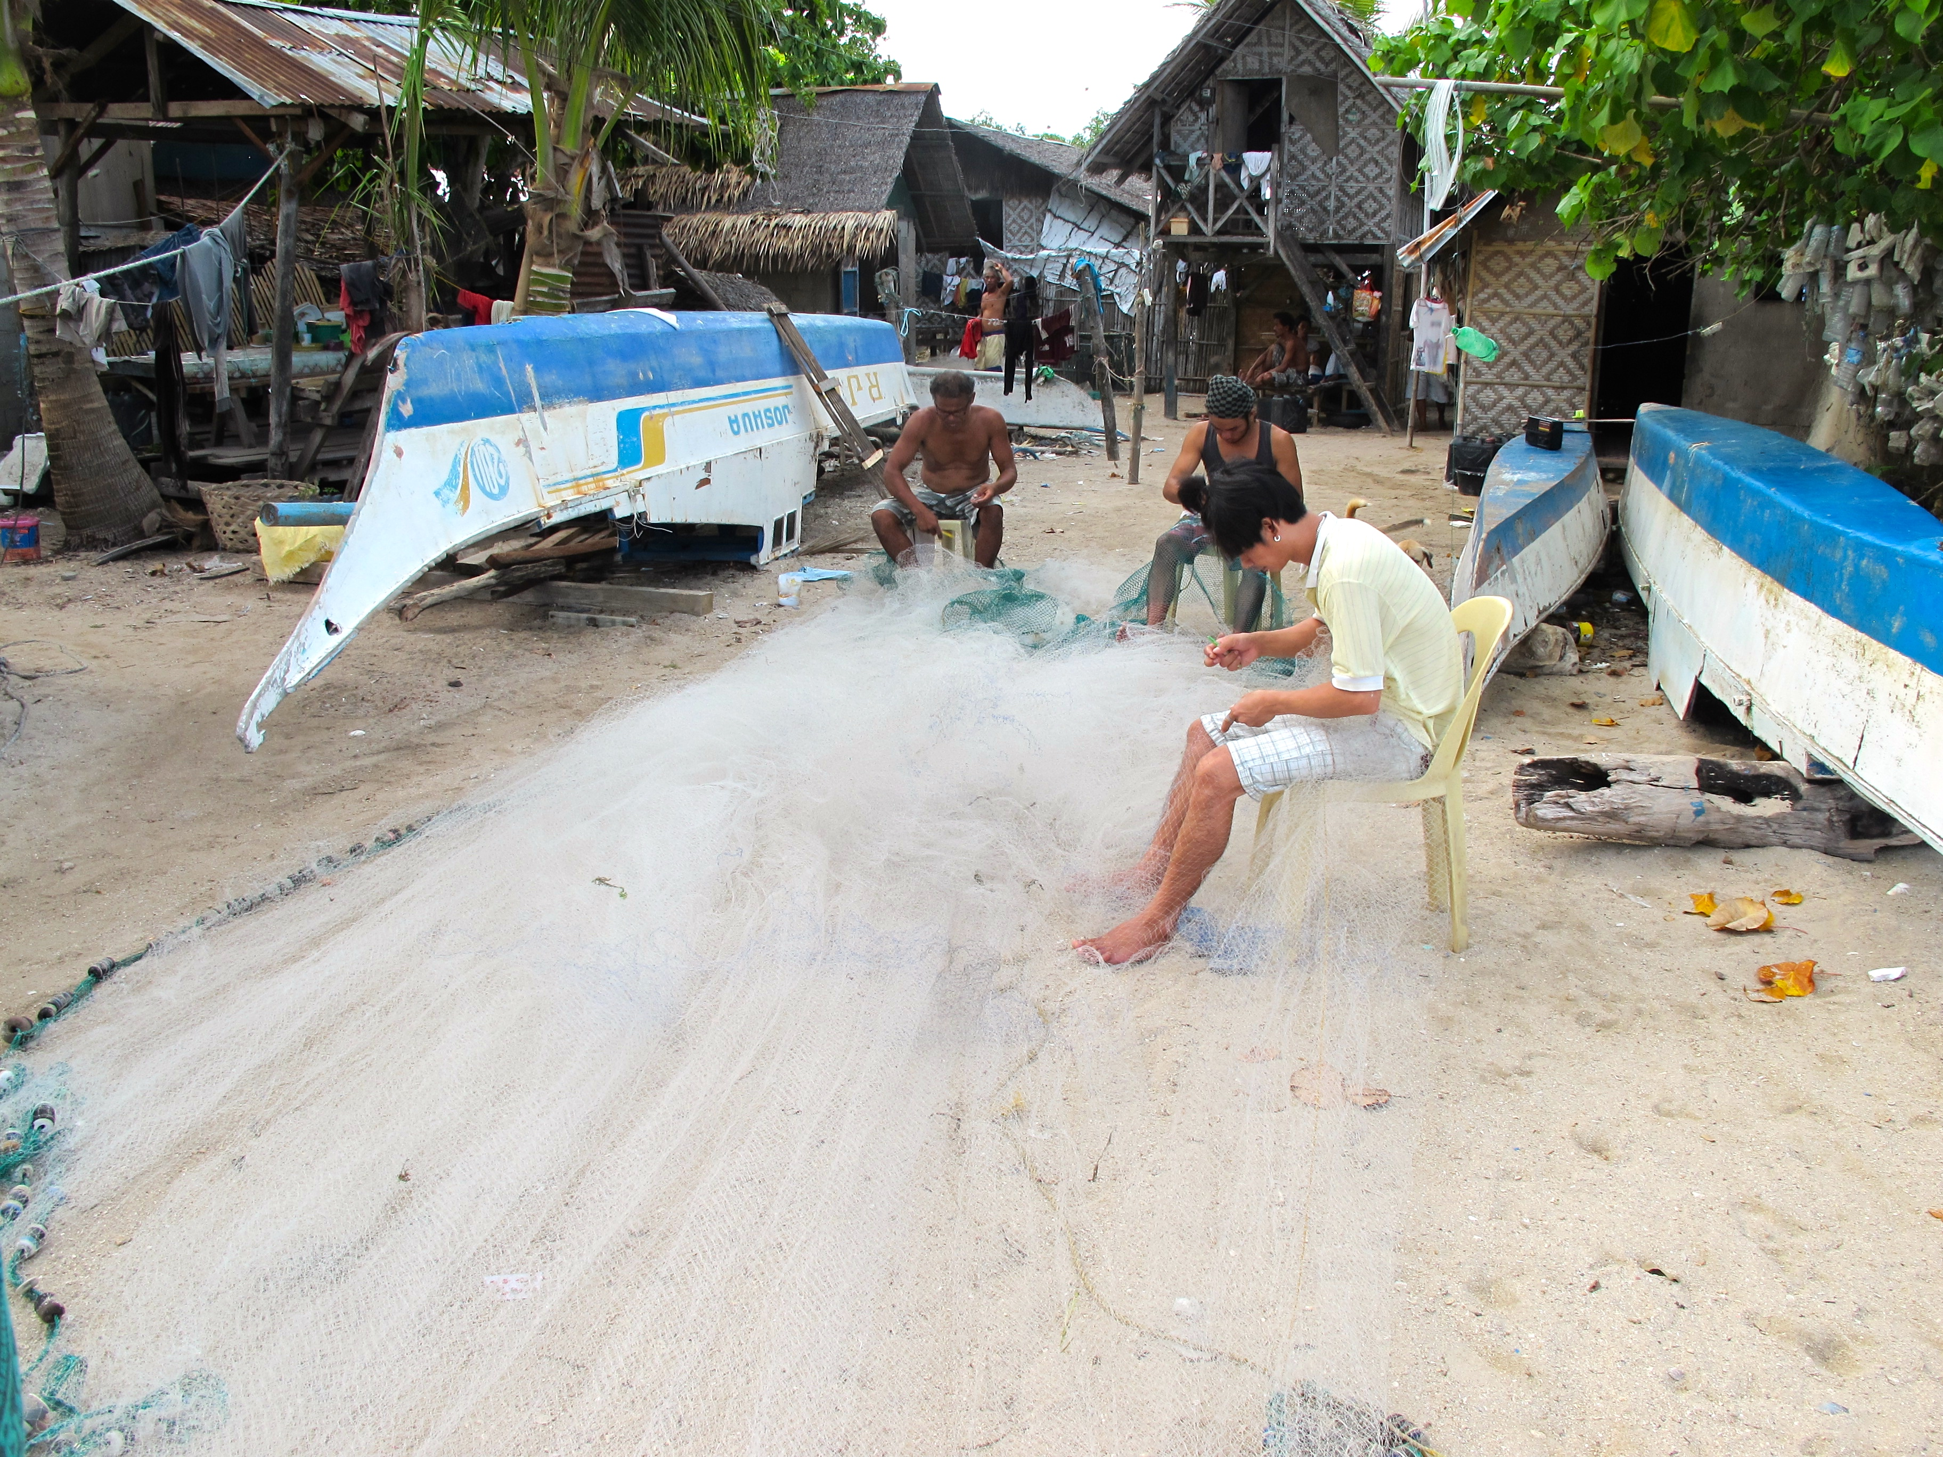
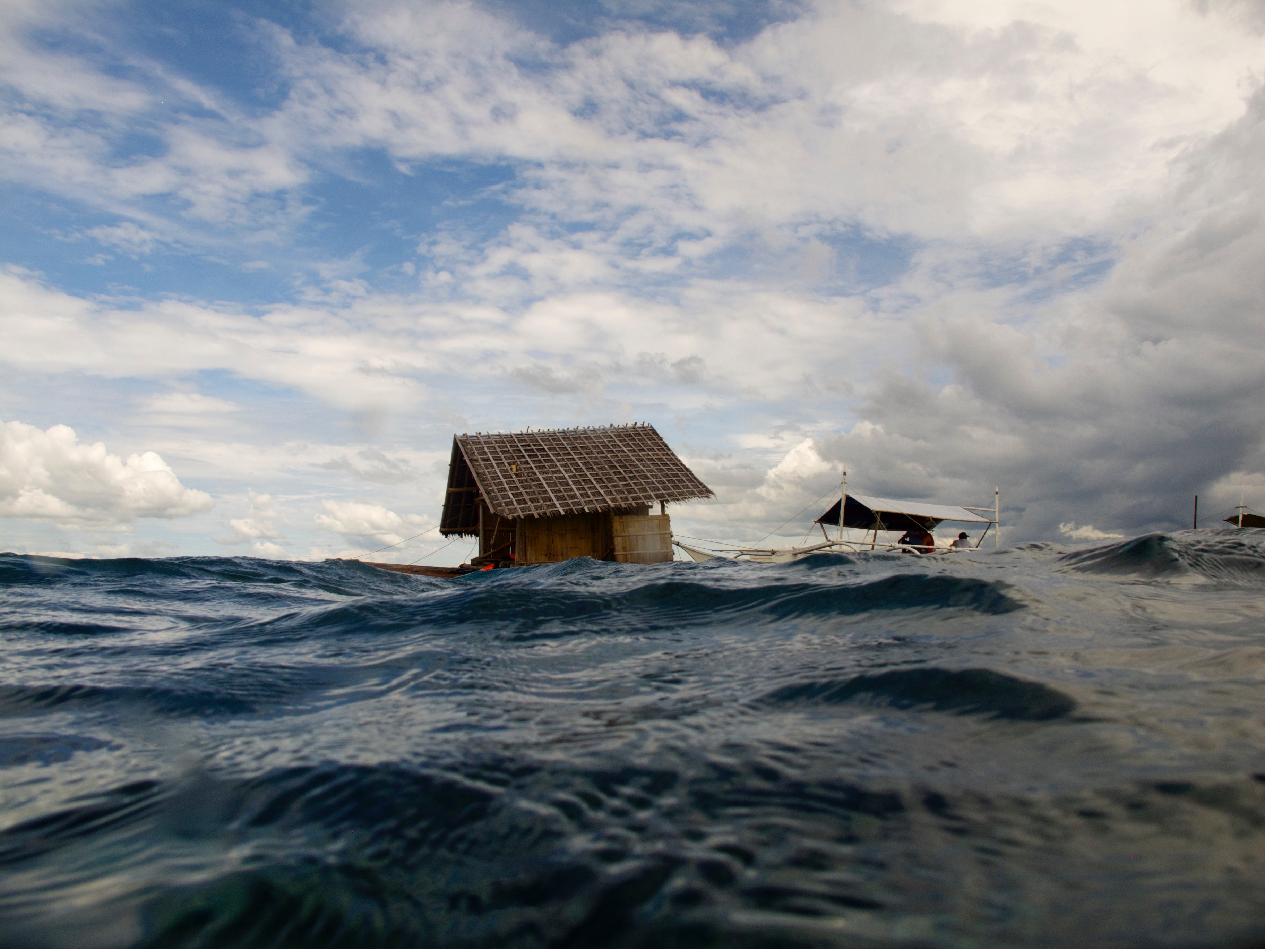
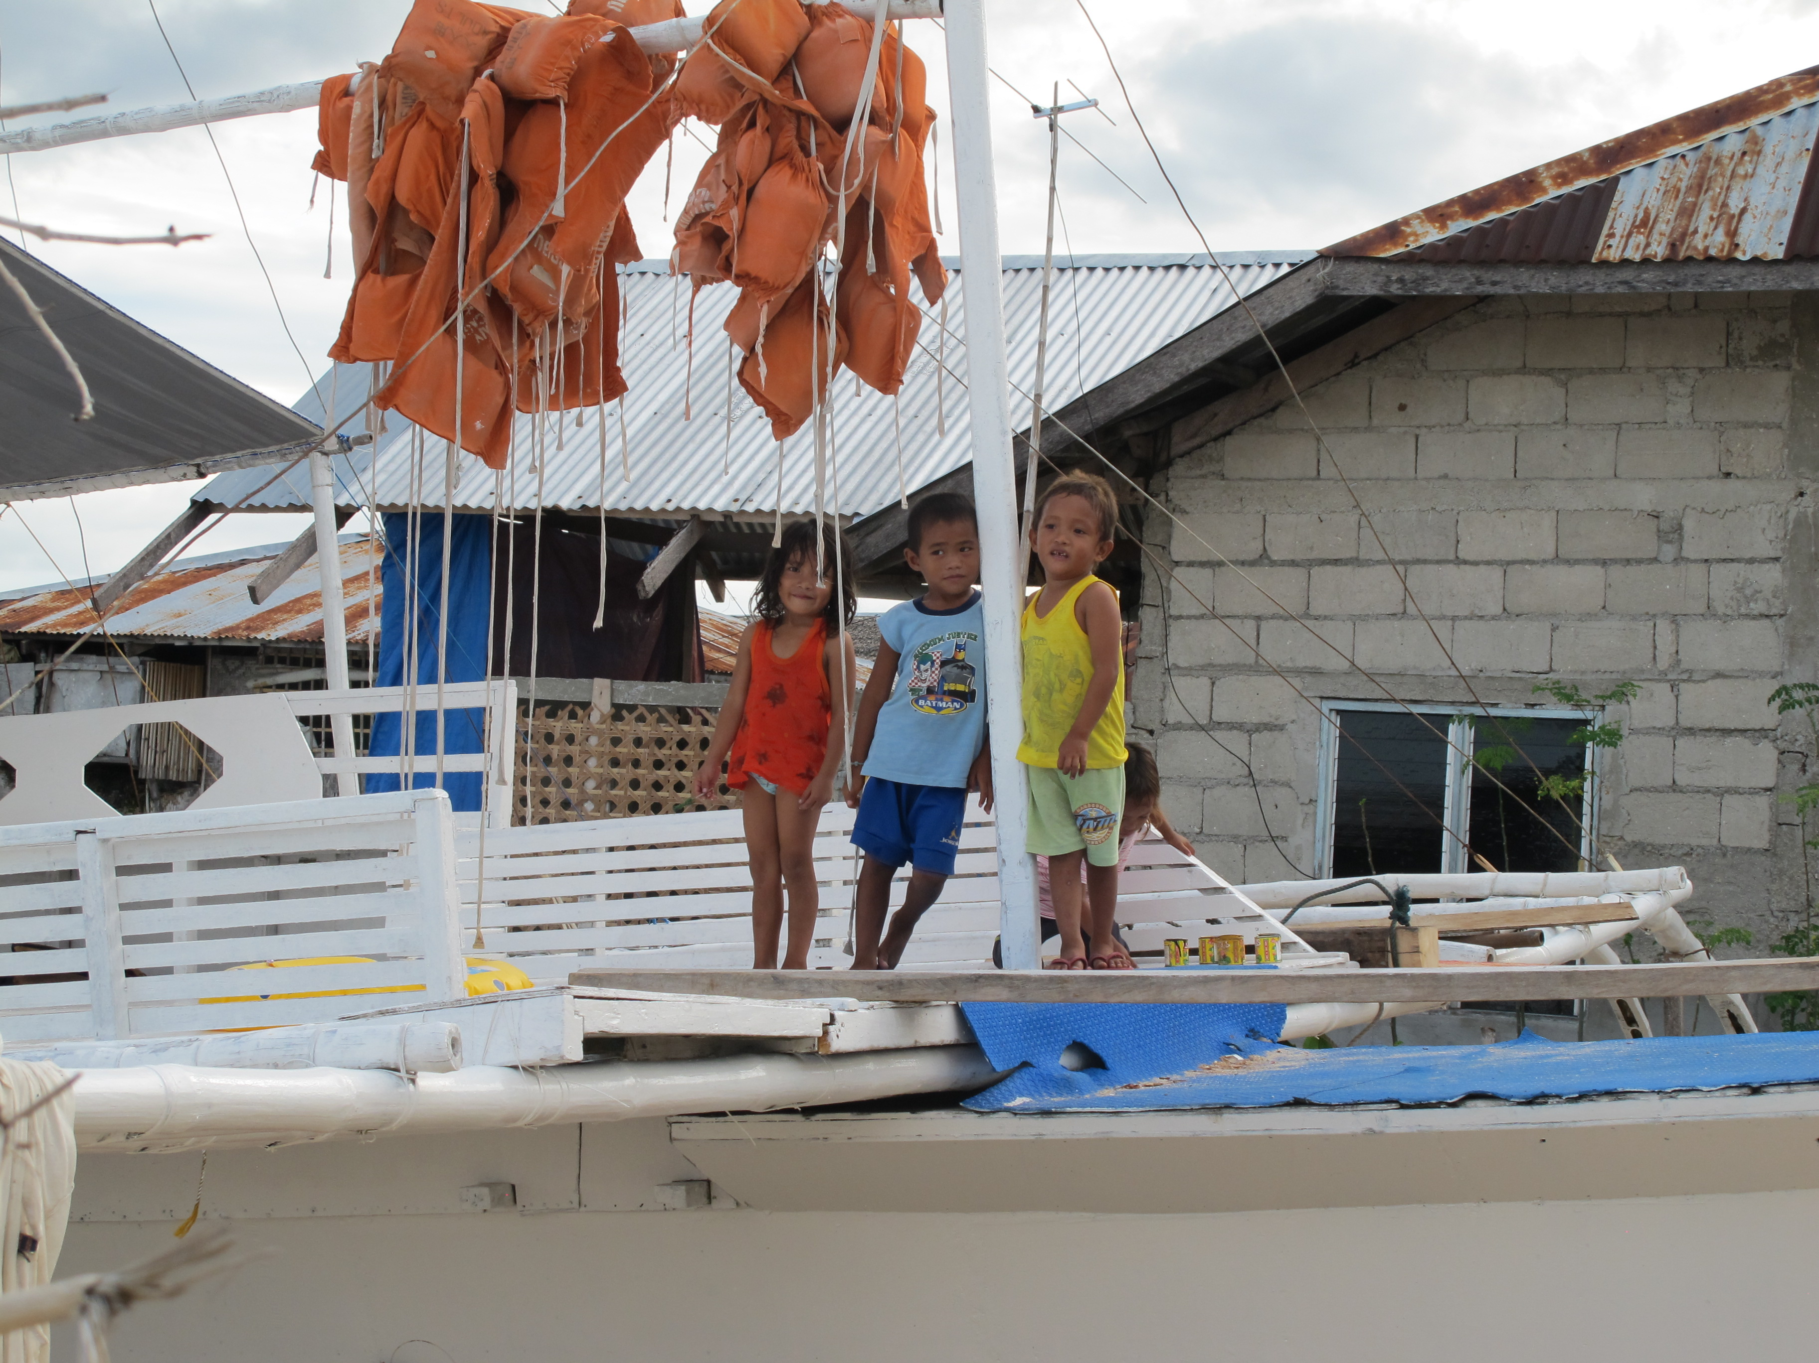

Slide 3
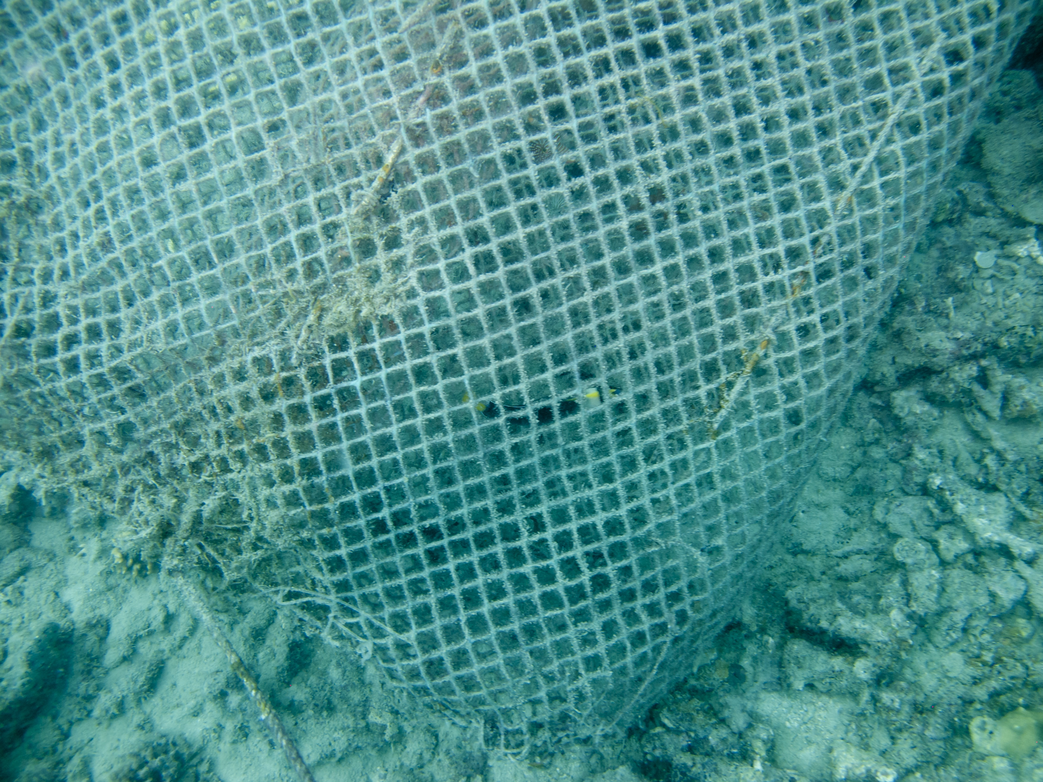

Slide 4
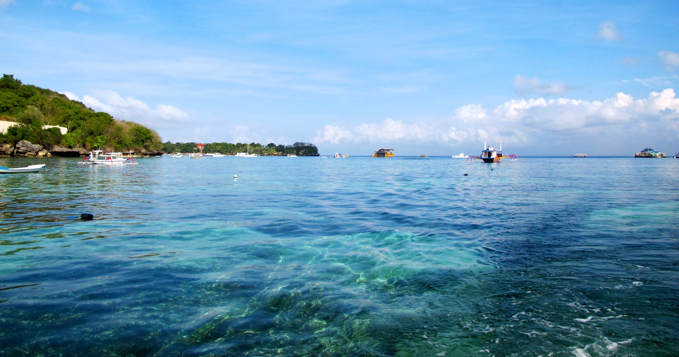
How do Reserves Affect a Community’s Short-Term Economic Well-Being?
Notes:
You’re making an area off limits to fishing, we all know that that has important ramifications
We felt that there’s already a lot of activity focused on this question of do reserves help or not. What’s been missing in this debate though has been a discussion of the short-term, what happens to the community in the first few years after putting a reserve in place.
How long until a communities investment pays off?

Slide 5
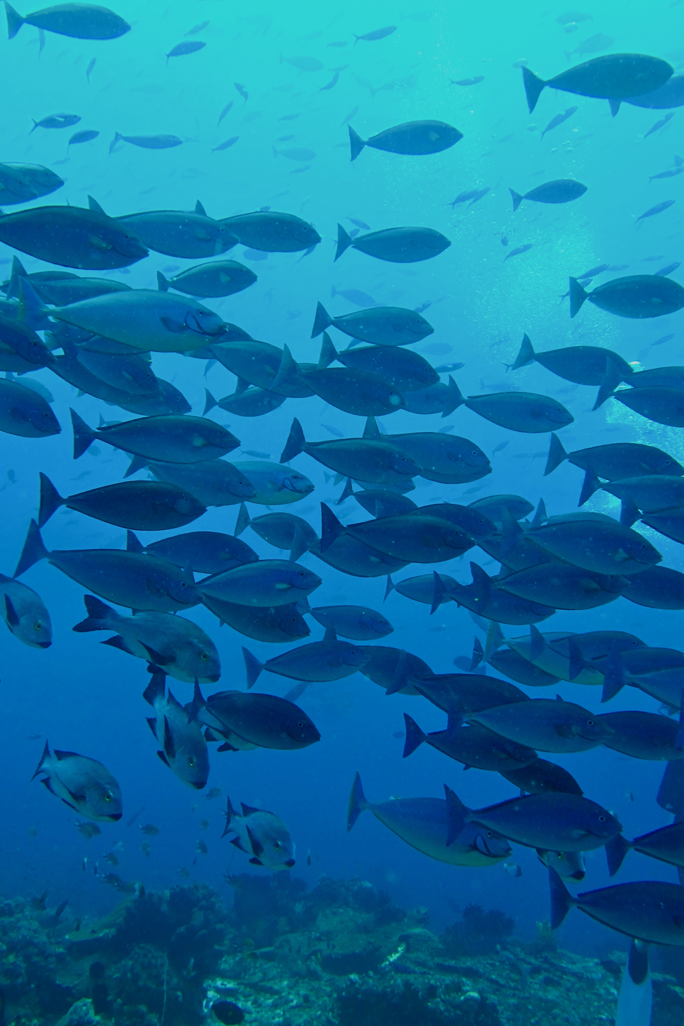
Our Hypotheses:
Discount rate matters
Reserve design can reduce short-term losses
Financial tools can offset short-term losses
Notes:
Start with motivation: helping communities and ecosystems
What are we going to be looking at

Slide 6
Our Tools
Net Present Balance: The net difference in discounted fishing benefits with and without a reserve
Design: The size of the reserve over time
Discount rate: The value of money tomorrow compared to money today
Loans: a loan to offset short-term losses, paid back with long-term gains
Value Increase: an increase in the value of catch
Notes:
Start with motivation: helping communities and ecosystems
What are we going to be looking at

Slide 7
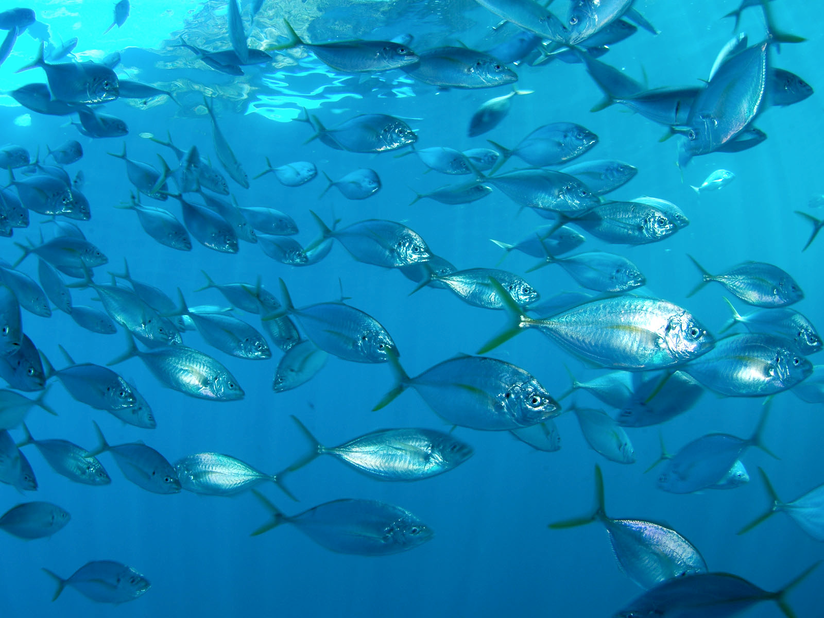
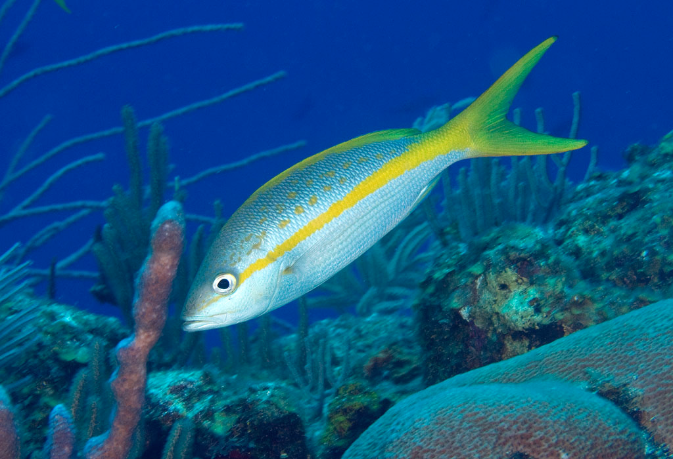
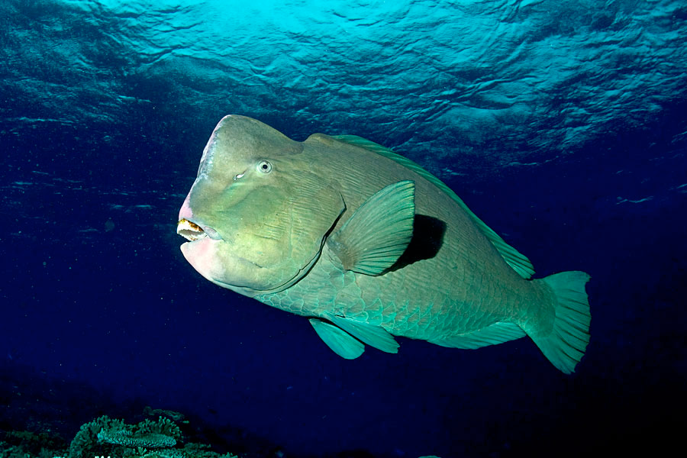
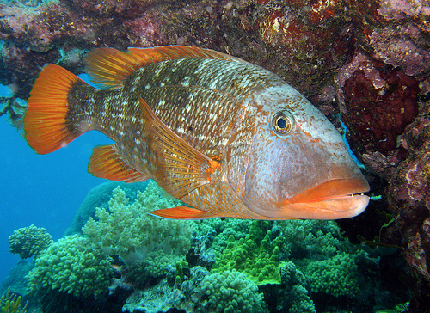
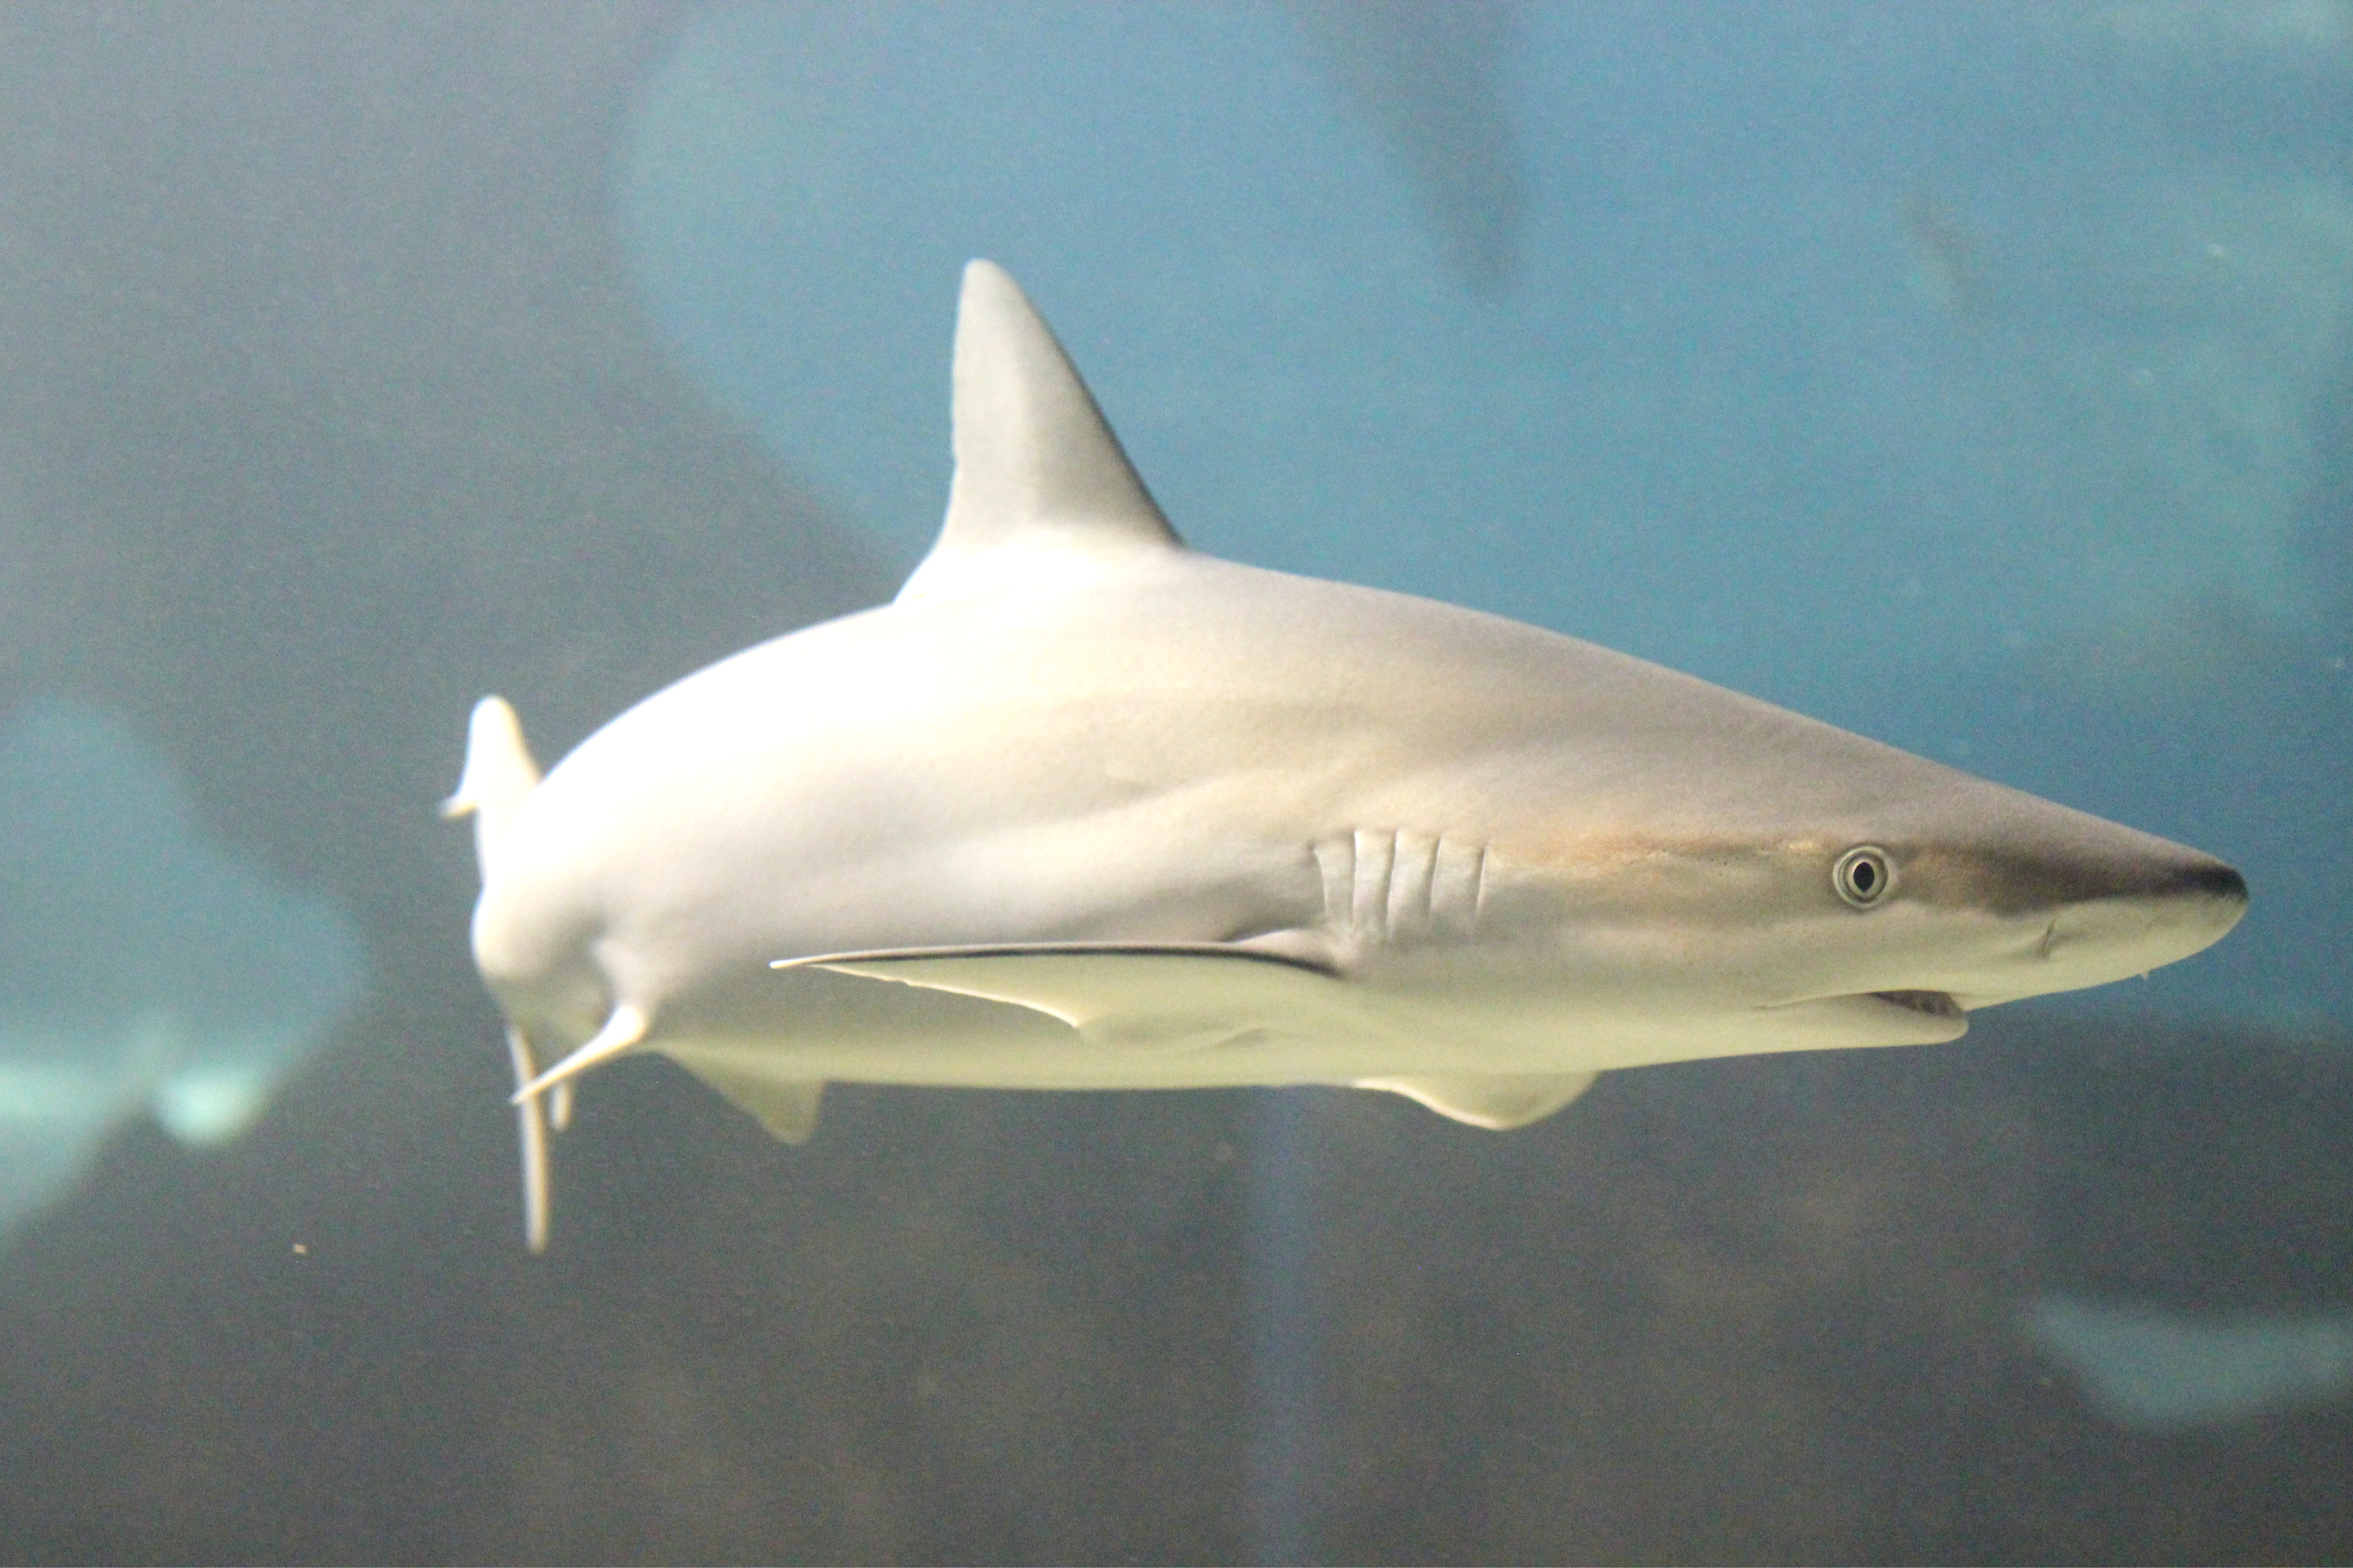
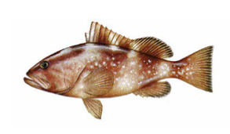
Model Species

Slide 8
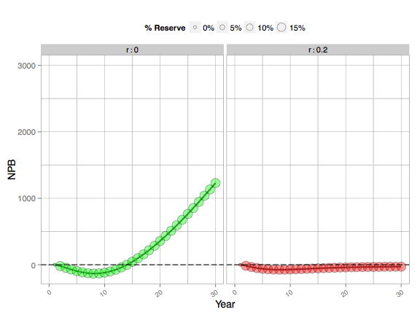
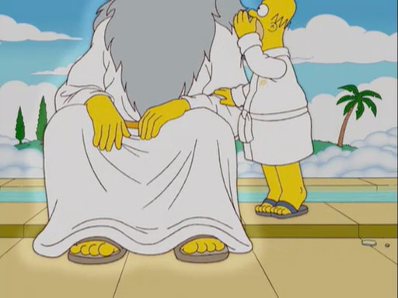
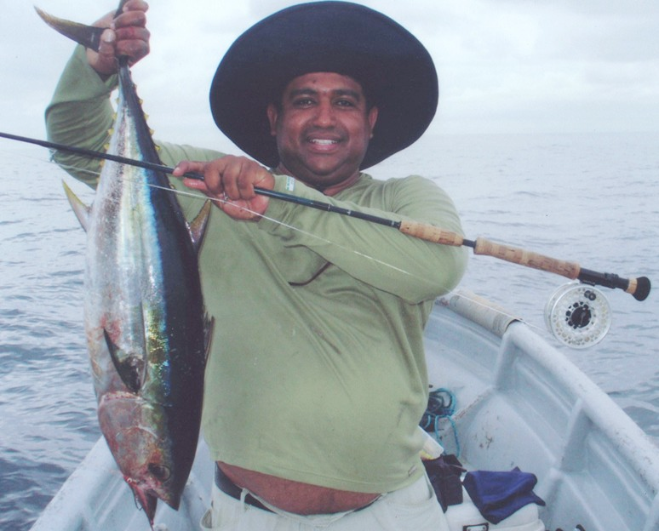
Notes:
average is about 17 years for the communities investment in the reserve to pay off

Slide 9
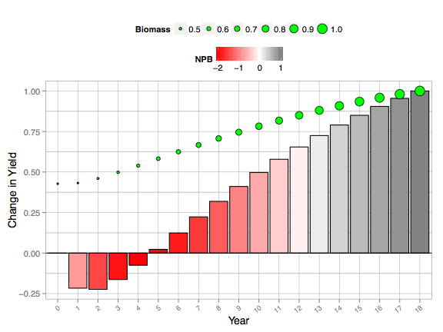
Net Benefit
Achieved
Change in
Catch Increases
Reserve Created
Notes:
We’re talking about catches
Box around the negative values
Yield Benefit
Conservation benefits
How long does it take for the green area to make up for the red area? How long does it take for the investment to pay off

Slide 10
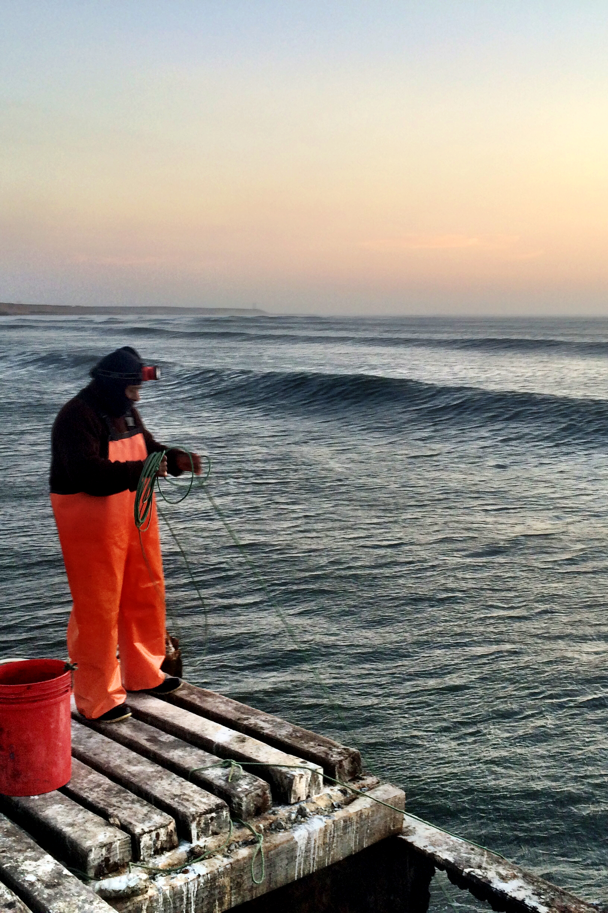
Can Design Help?
Notes:
You’re making an area off limits to fishing, we all know that that has important ramifications
We felt that there’s already a lot of activity focused on this question of do reserves help or not. What’s been missing in this debate though has been a discussion of the short-term, what happens to the community in the first few years after putting a reserve in place.
How long until a communities investment pays off?

Slide 11
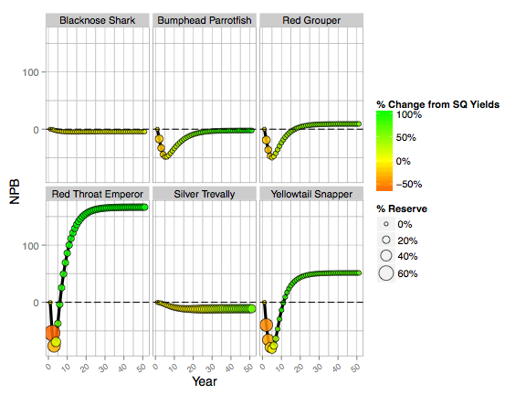

Slide 12
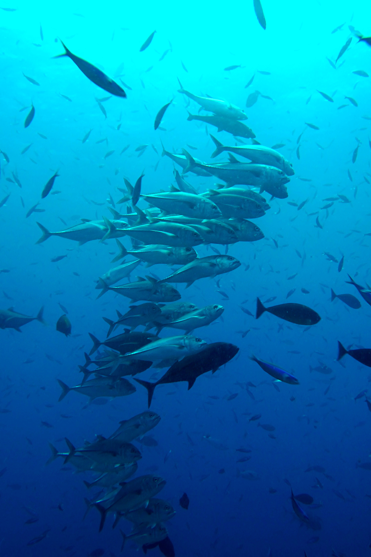
Can Finance Help?

Slide 13
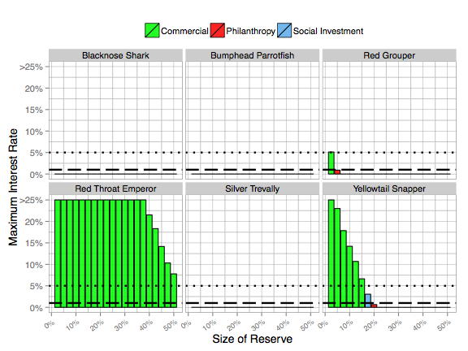
Notes:
Long term optimal
Short term optimal

Slide 14
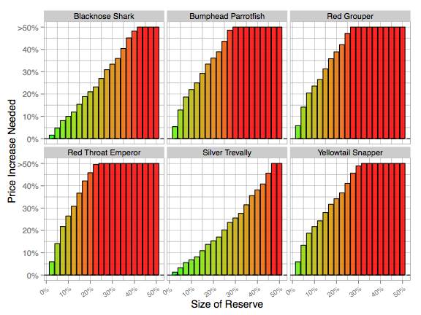
Notes:
Long term optimal
Short term optimal

Slide 15
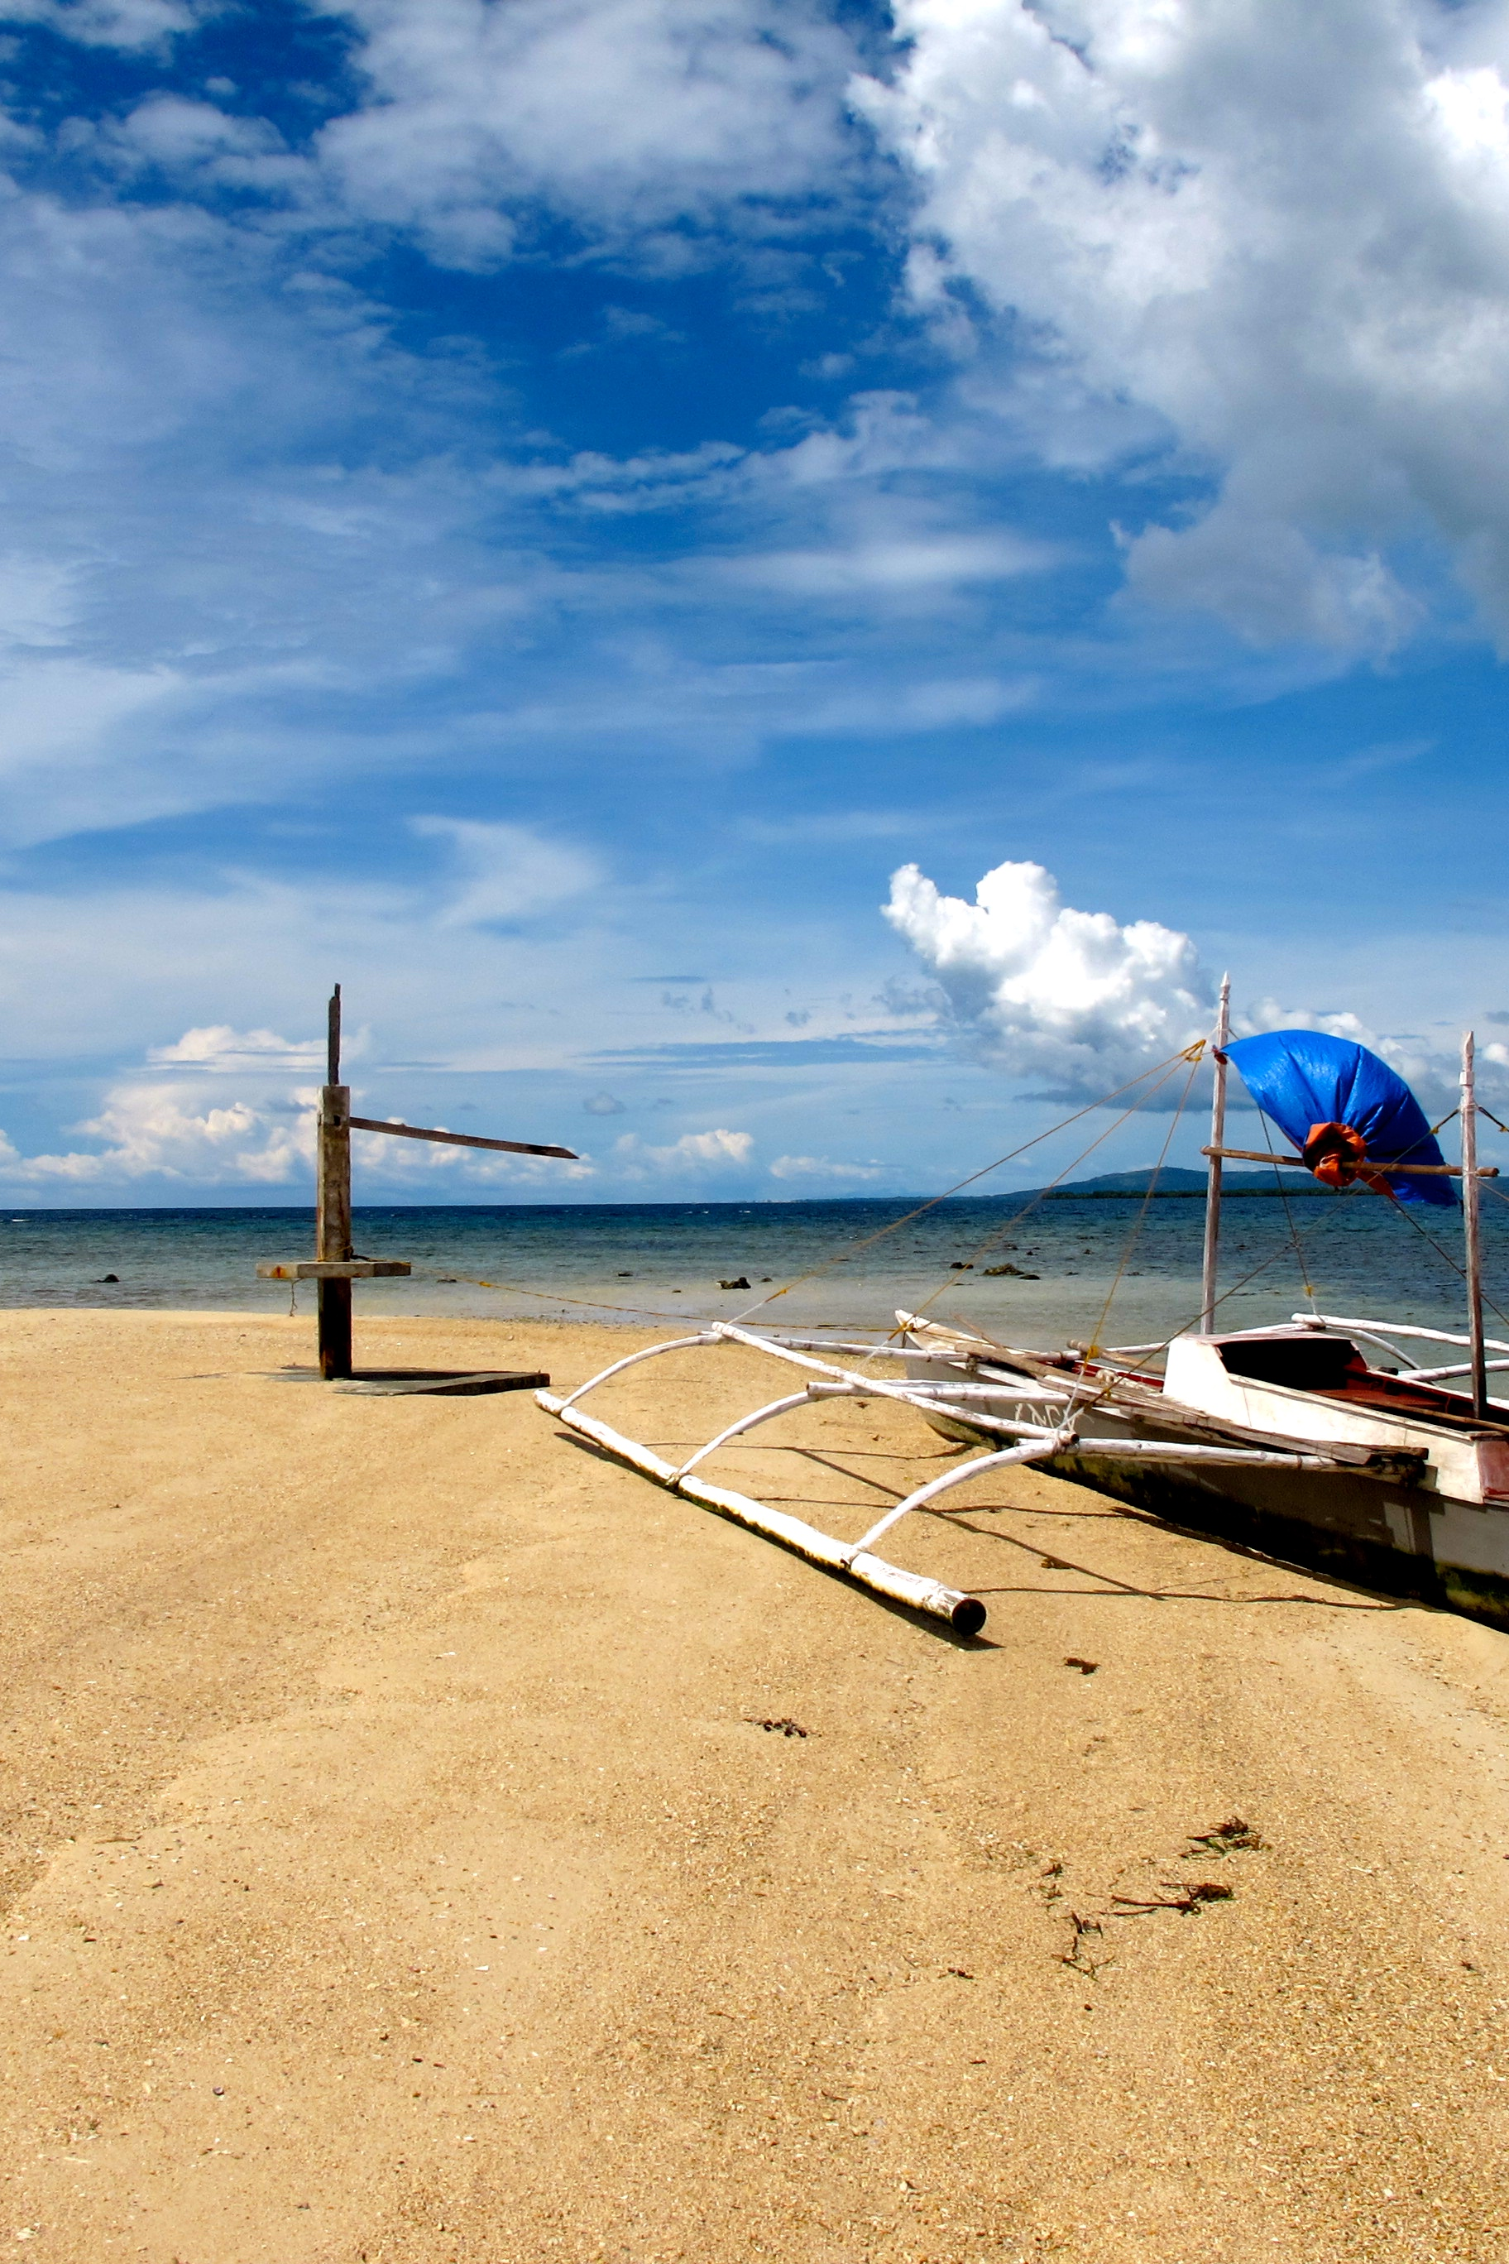
Reserves struggle to provide short-term benefits, Design can reduce, but not eliminate, short-term losses
Value increase show potential to offset short-term losses
We need to better assess and communicate the short-term economic impacts of reserves
Notes:
We all want the long term healthy fishery

Slide 16
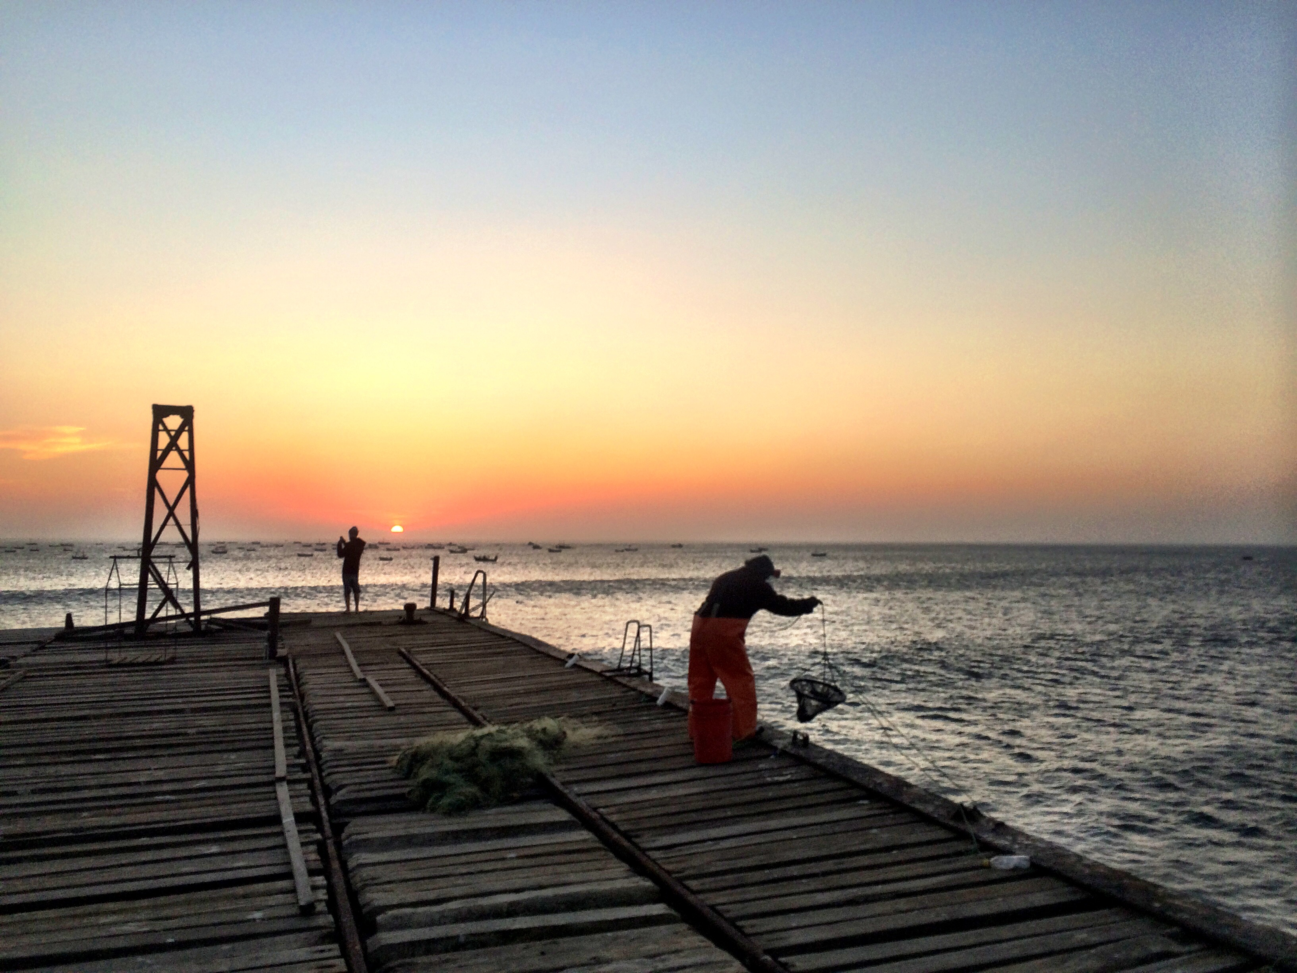
Thank you!

Slide 17
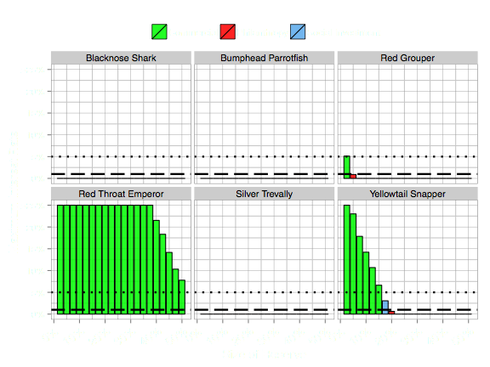
Notes:
Long term optimal
Short term optimal

Slide 18
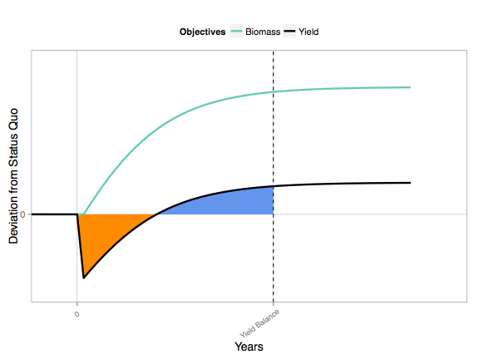

Slide 19
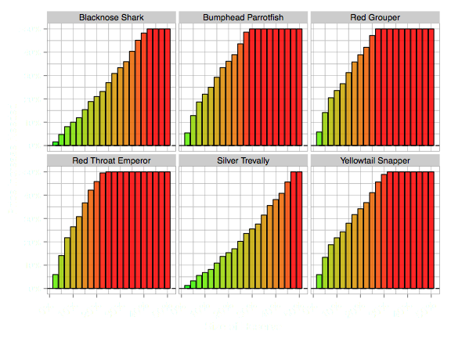
Notes:
Long term optimal
Short term optimal

Slide 20
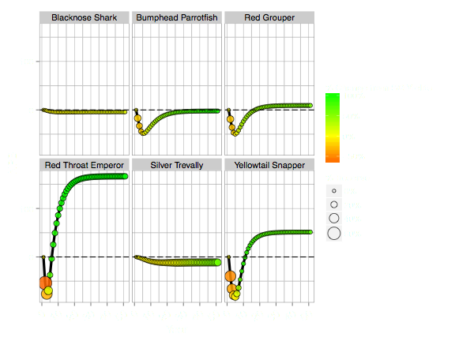

Slide 21
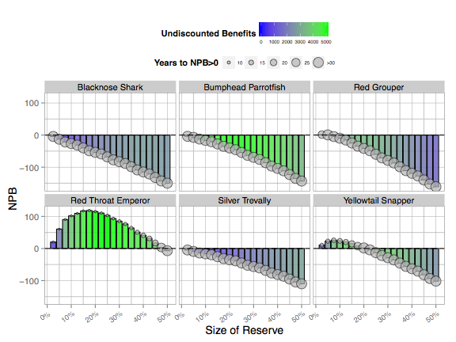

Slide 22
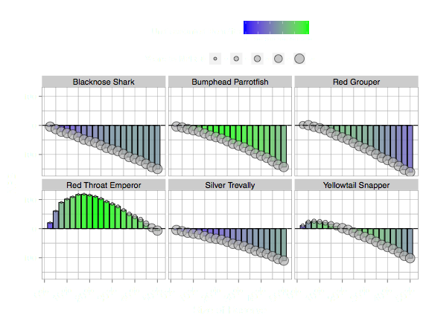

Slide 23
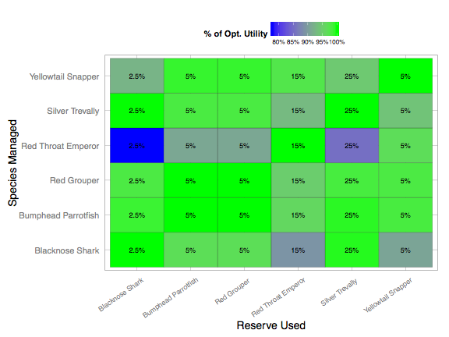

Slide 24
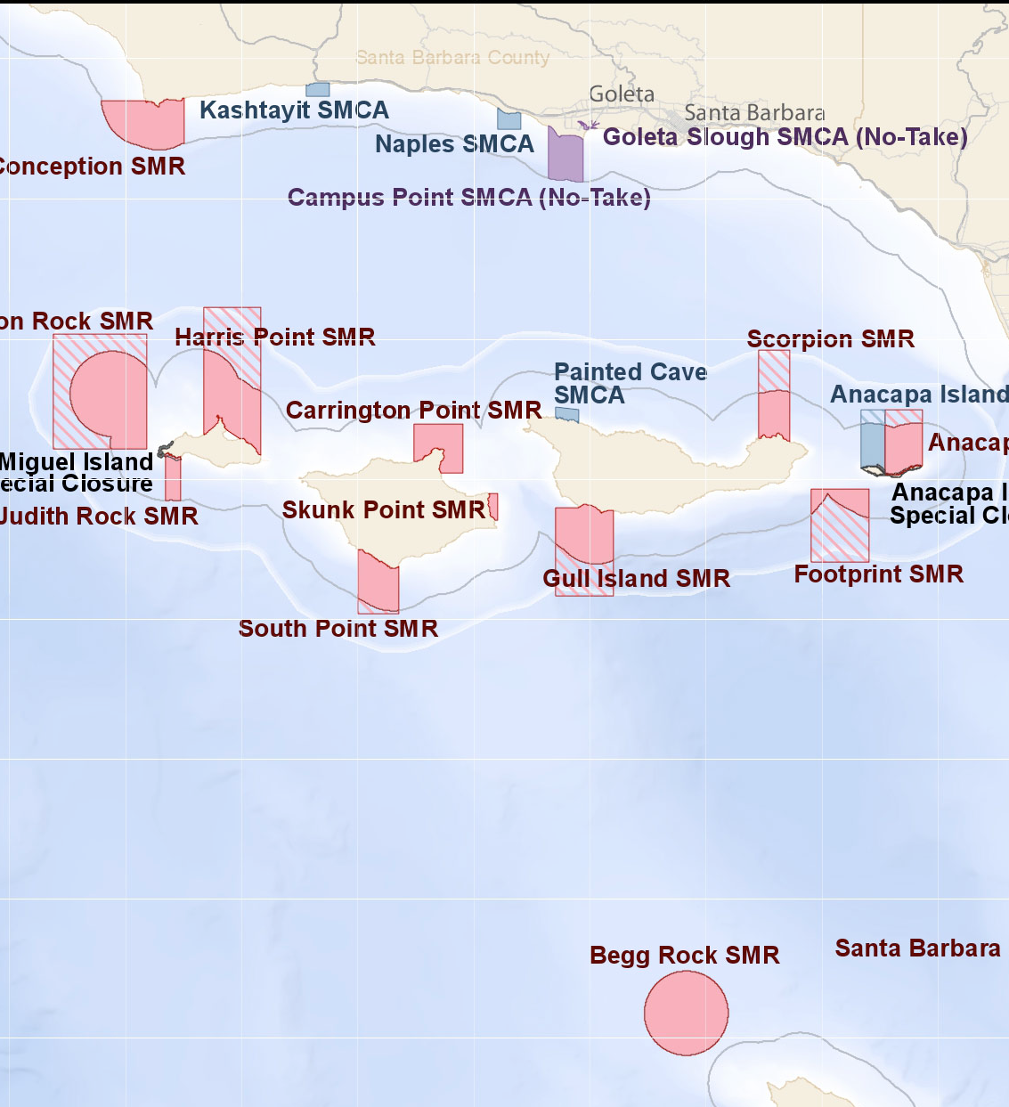
Why Marine Reserves?
No-take marine reserve: area of the ocean protected from fishing
Oceans face many risks
Fisheries are a critical source of food, income, and employment
Marine reserves may be a simple and effective tool to protect marine ecosystems and livelihoods
Notes:
You’re making an area off limits to fihsing, we all know that that has important ramifications

Slide 25
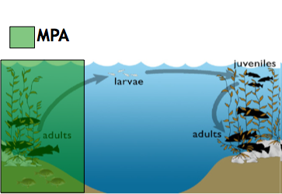
Reserves and Fisheries
Fish inside reserve get larger and more abundant
Act as “bank” for fished area
Notes:
So, the hope is we get more fish inside, we get more fish outside, everybody wins.

Slide 26
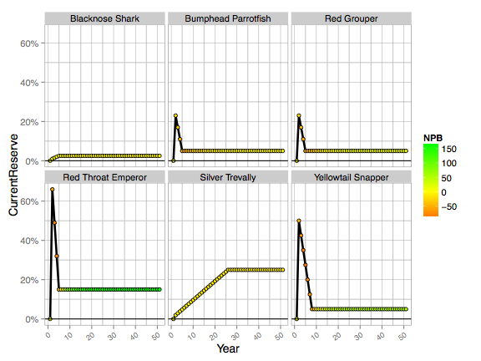

Slide 27
